Slide 2
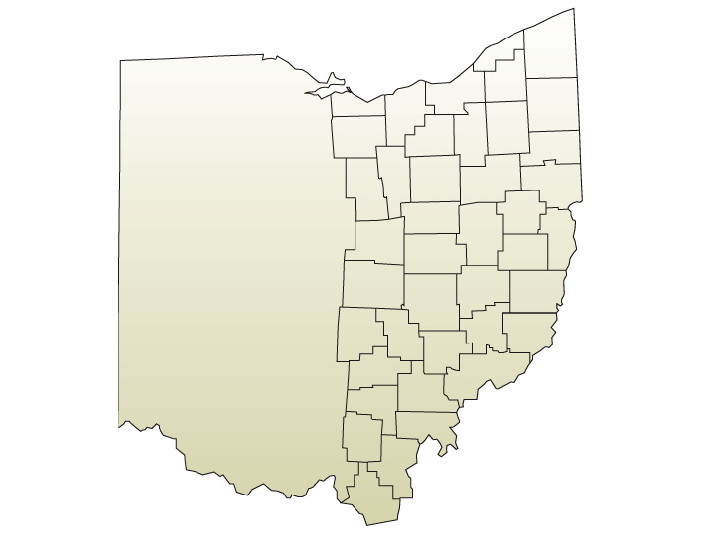
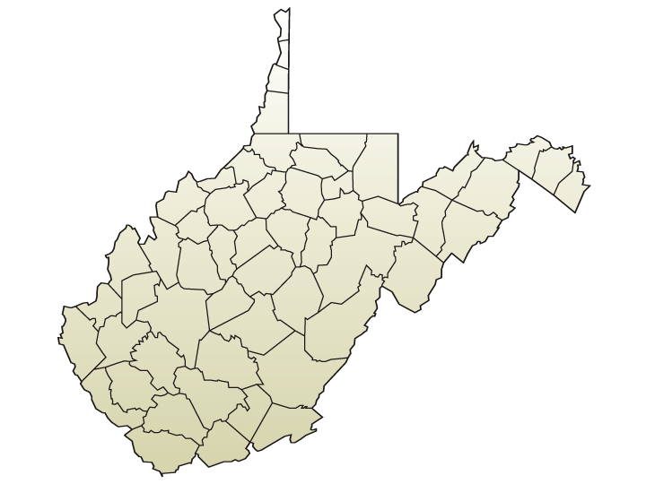
Church Planting throughout the 7.3 million people who live within the geography of the Central District of the C&MA
Learn more at cdcma.org/church-planting

Slide 3
Church planting in Amherst - Restoration Church
Planter picture
Join with them in prayer for -
Financial stability
Partnership with El Salvadorian church plant
Starting 3 more house churches
Laborers (Luke 10:2)
Power to witness (Acts 1:8)
Resources for disciple making
Learn more at cdcma.org/church-planting

Slide 4
Church planting in Parma – Parma Alliance Church
Planter picture
Join with them in prayer for -
Clarity of discipleship format
Multiplication of small groups
Increased engagement in reaching the lost
Start of large group worship gathering
Learn more at cdcma.org/church-planting

Slide 5
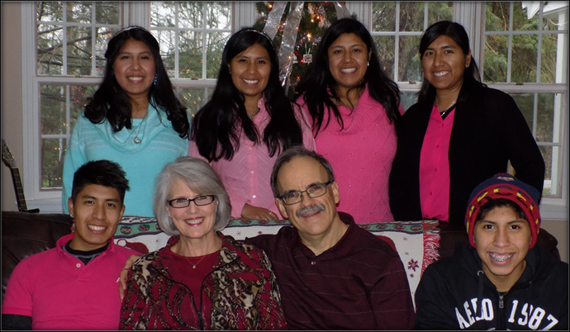
Church planting among the Hispanic-Painesville Hispanic C&MA Church
Join with them in prayer for –
Many to respond to the Gospel
Multiplication of leaders
Strengthening of new believers
Learn more at cdcma.org/church-planting

Slide 6
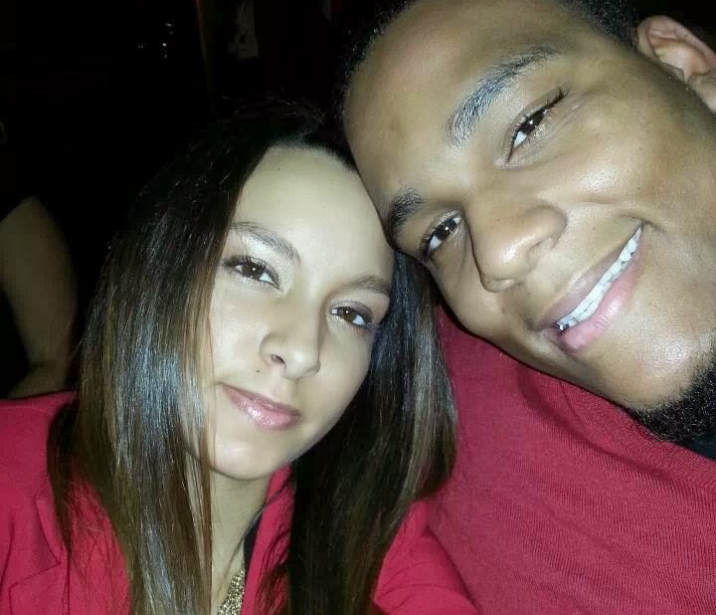
Church planting in Sandusky – Sandusky Life Church
Join with them in prayer for -
Start of large group worship gathering
Discipleship footprint increased
People added to their number
Open hearts to be receptive to the Gospel
Establish strong relationships with community organizations
Learn more at cdcma.org/church-planting

Slide 7
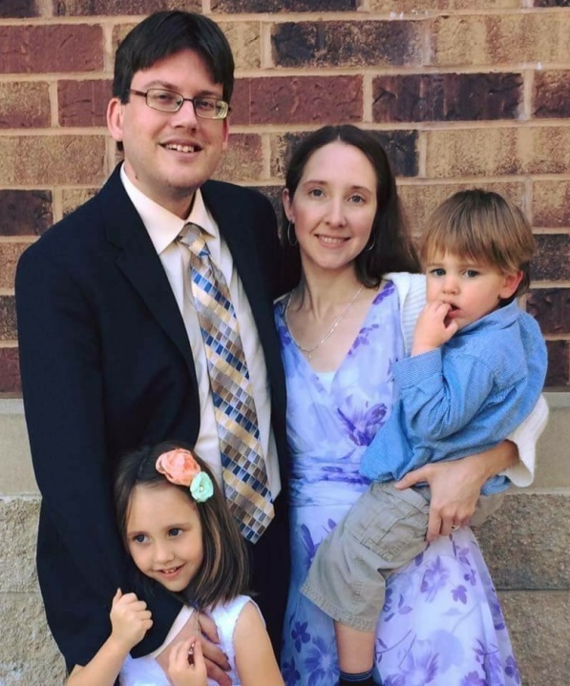
Church planting among the deaf – Signs of Grace Church
Join with them in prayer for -
Stronger evangelistic impact
Clarity of discipleship process
Move to accredited church status
Learn more at cdcma.org/church-planting

Slide 8
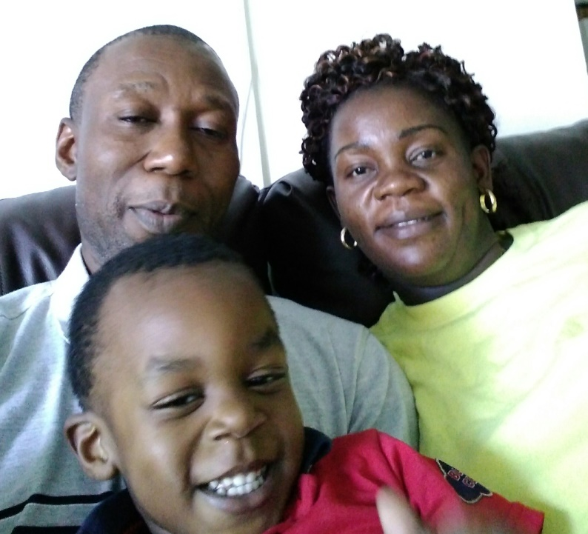
Church planting among the Congolese – Amour Du Christ
Join with them in prayer for -
A movement of the Lord among the Congolese
Stronger evangelistic engagement from believers
Financial stability
Learn more at cdcma.org/church-planting

Slide 9
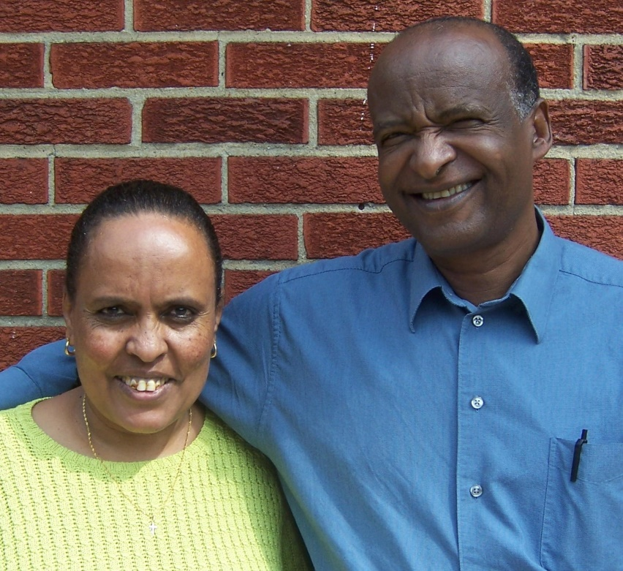
Church planting among the Ethiopian and Eritrean – Ebenezer Church
Join with them in prayer for –
Continued salvation growth
Growth in financial stability
Moving towards full church status
Learn more at cdcma.org/church-planting

Slide 10
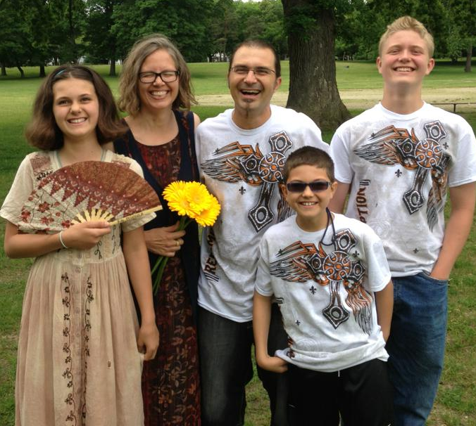
Church planting in the Clark Fulton neighborhood – metroChurch
Join with them in prayer for -
Participants to engage in making disciples
Financial provisions
The continued settling in of the Heuberger family
Transition of the Ammari family
Learn more at cdcma.org/church-planting

Slide 11
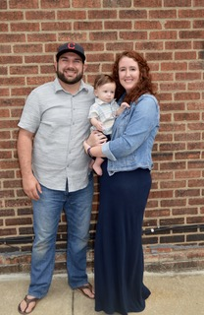
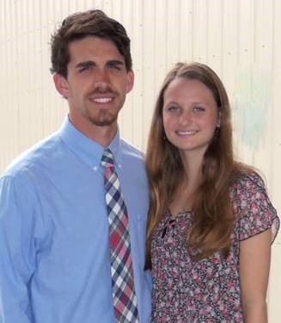
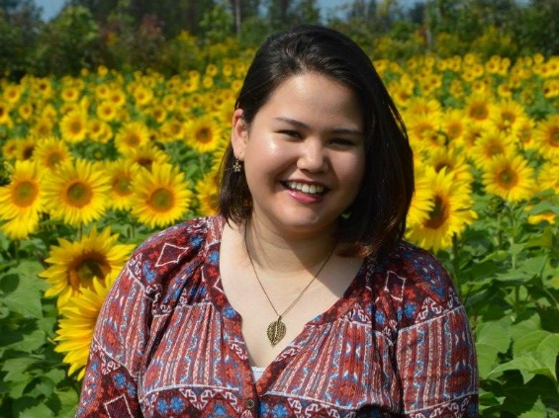
Disciple making among Refugees – Refugee Impact Collaborative
Join with them in prayer for -
More people to join the team
More refugees coming to Christ
Greater discipleship opportunities
Ongoing effective development for overseas ministry
Learn more at cdcma.org/church-planting

Slide 12
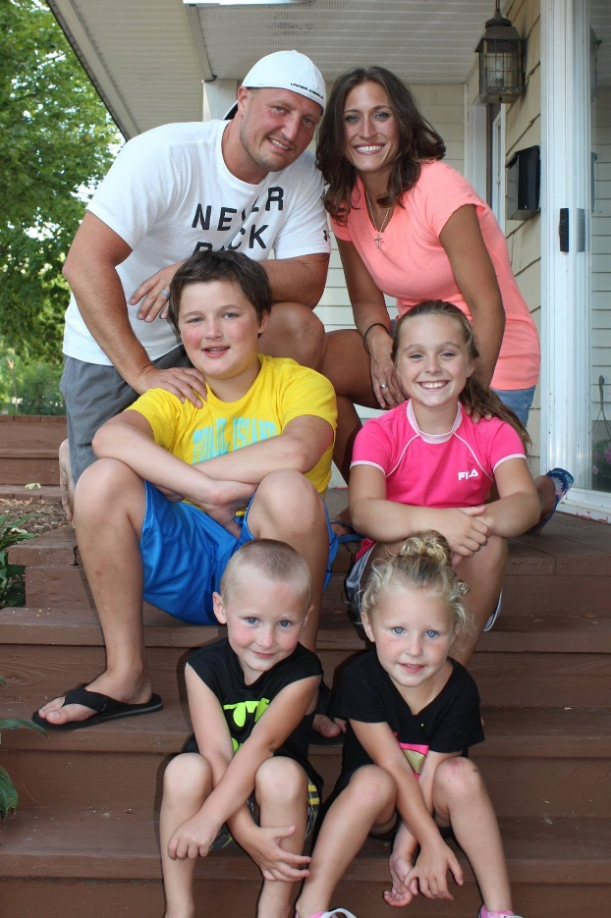
Church Planting among addicts – Really Recovered
Join with them in prayer for -
More leaders to join the team
More addicts coming to Christ
Wisdom in multiplication
For the beginning of the Akron venue
Learn more at cdcma.org/church-planting

Slide 13
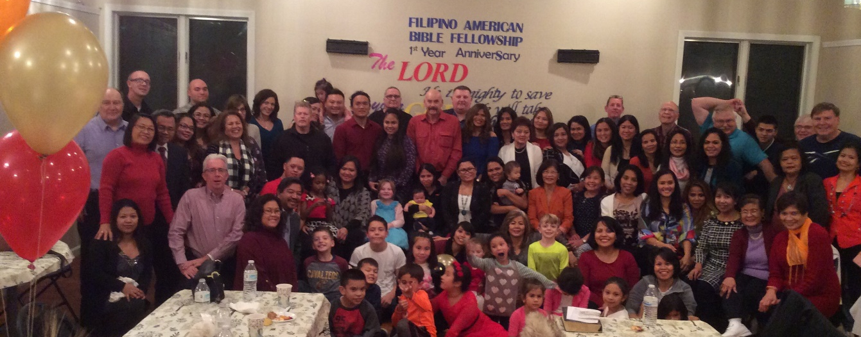
Church planting among Filipinos – Filipino Alliance Bible Fellowship
Join with them in prayer for -
More people to join the team
More people to come to Christ
Greater discipleship opportunities
Wisdom in location options
Learn more at cdcma.org/church-planting

Slide 14
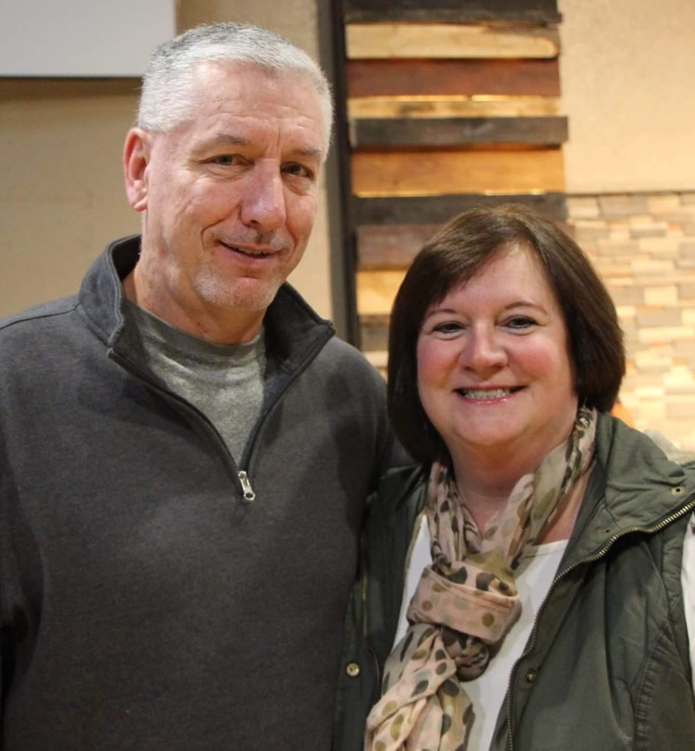
Church planting in West Virginia
Join with them in prayer for -
Ongoing sports outreach ministry – Mpact sports
A movement of the Holy Spirit leading to salvations and disciple making of the responsive
For gifted leaders to join
Learn more at cdcma.org/church-planting

Slide 15
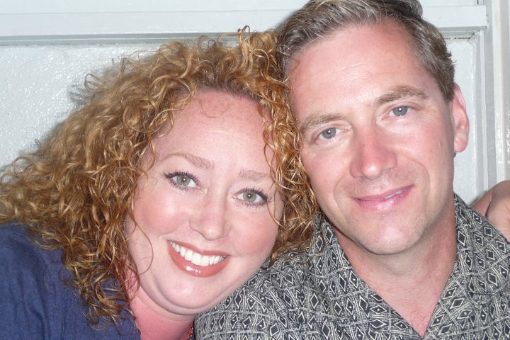
Church planting in Capon Bridge – Capon Bible Fellowship
Join with them in prayer for –
Impacting the community
Clarity of disciple making efforts
Financial stability
Strengthening of leadership team
Learn more at cdcma.org/church-planting

Slide 16
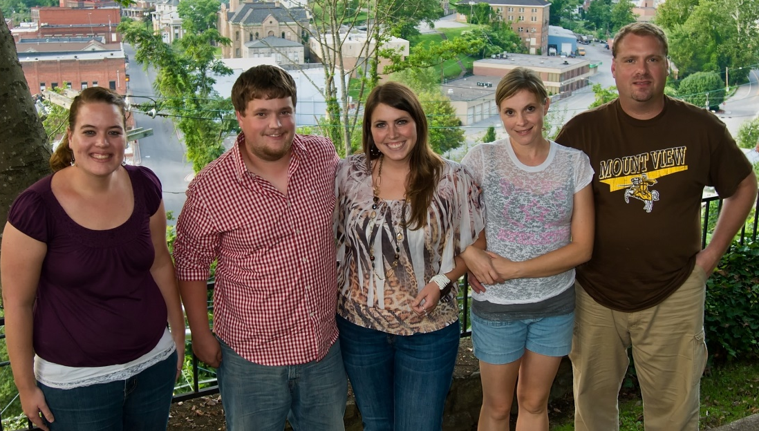
Disciple making in McDowell County
Join with them in prayer for -
A harvest of workers at multiple professional levels
Spiritual health of our workers
Dozens of HS/MS students saved thru Young Life
Financial support for our Young Life leader family
Renewed church planting possibilities
Learn more at cdcma.org/church-planting

