Slide 1
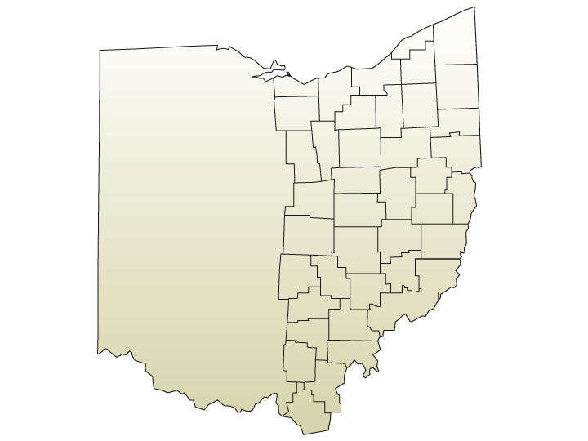
Church planting in Parma – Parma Alliance Church
Planter picture
Join with them in prayer for -
Clarity of discipleship format
Multiplication of small groups
Increased engagement in reaching the lost
Start of large group worship gathering
Learn more at cdcma.org/church-planting

